Slide 1
FIN 654: FINANCIAL Analytics
SUPPLEMENT Week 3
Note: Code contained here is from a mix of sources as listed in References Slide(s)

Slide 2
Financial Markets
Financial market data are characterized by empirical statistical regularities, known as “stylized facts”
Excess volatility: observed variability hard to explain with variations in variables – specifically, the occurrence of large returns whether positive or negative
Heavy tails: distributions of returns show heavy tails with positive excess kurtosis
Volume/volatility correlation: trading volume is positively correlated with market volatility
Volatility clustering: “large changes tend to be followed by large changes, of either sign, and small changes tend to be followed by small changes” – [Mandelbrot]
Volatility clustering is recognized as a stylized property present in most financial time series.
Empirical studies focus on simple returns and log-returns
Simple returns
The one-period simple return on assets
R_{t} = (P_{t} – P_{t-1}) / P_{t-1}
The k-period simple return on assets
R_{t}[k] = (P_{t} – P_{t-k} / P_{t-k}
Log-returns
When interest is paid m times a year, the total deposit is
(1 + 1/m R_{t} )^{m}
When interest is cumulated continuously (m → ∞)
lim (1 + 1/m R_{t} )^{m} = e^{r(t)}
The continuously compound return is the log-return
r_{t} = log(P_{t}) – log(P_{t-1}) = p_{t} – p_{t-1}
The continuously compounded return is the log-return
Example: exrates.r <- diff(log(as.matrix(exrates[, -1]))) * 100

Slide 3
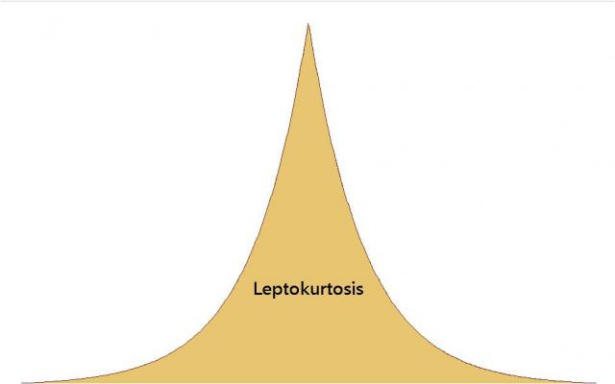
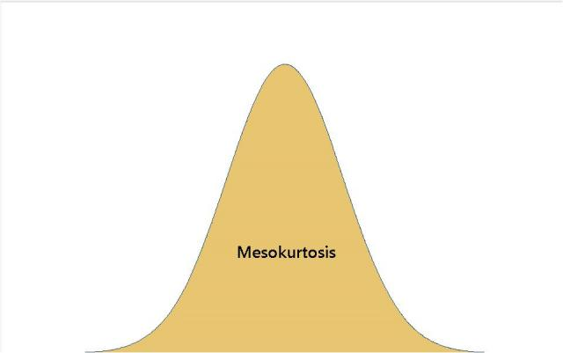
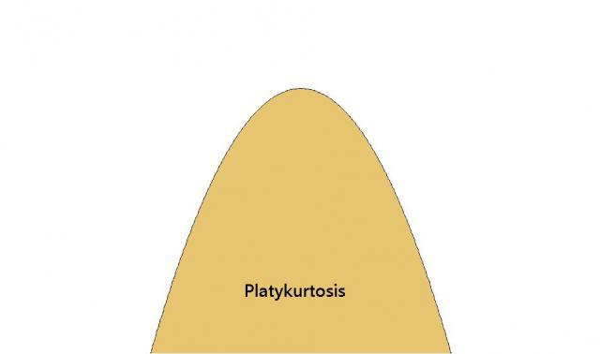
More Kurtosis
Types of Kurtosis
Lepto means "thin" or "slender" in Greek. In leptokurtosis, the kurtosis value is high.
Platy means "broad" or "flat"—as in duck-billed platypus. In platykurtosis, the kurtosis value is low.
Meso means "middle" or "between." Mesokurtosis can be defined with a value of 0 (called its "excess" kurtosis value). The normal distribution is mesokurtic.
Using that benchmark, leptokurtic distributions have positive kurtosis values and platykurtic distributions have negative kurtosis values.

Slide 4
Time Series
univariate time series – measurements for same variable over time, not necessarily i.i.d.
purpose
describe features
explain the past
predict the future
quality control
considerations
trend
outliers
seasonality
cycles (unrelated to seasons)
variance
sharp changes in any characteristic
Autocorrelation reveal how persistent returns are over time.
classes
Stationary – strict implies higher moments are constant; weak implies variance is constant but higher moments are not
Non-stationary – requires transformation and differencing
Ordinary regression – uses time as x-variable
ARIMA (p,d,q) – Autoregressive Integrated Moving Average
AR(1) – autoregressive model of order 1 – linear model
ACF – autocorrelation – coefficient of correlation between two values in a time series – corr (y_{t} , y_{t -h}), where h = lag
PACF – Partial ACF – coefficient of correlation between two values in a time series filtering out intermediate influences
CCF – cross correlation function – is concerned with modeling of the relationship between two time series
Notes:
i.i.d. = independent and identically distributed

Slide 5
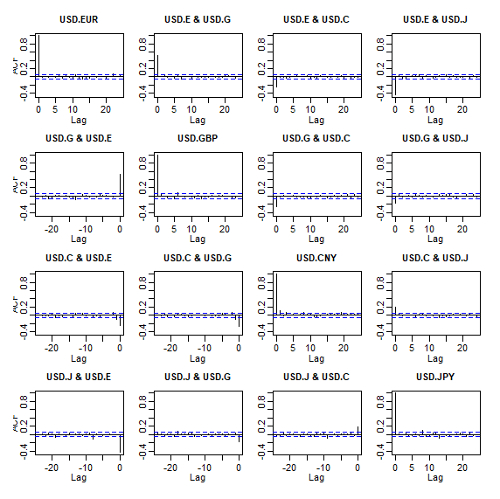
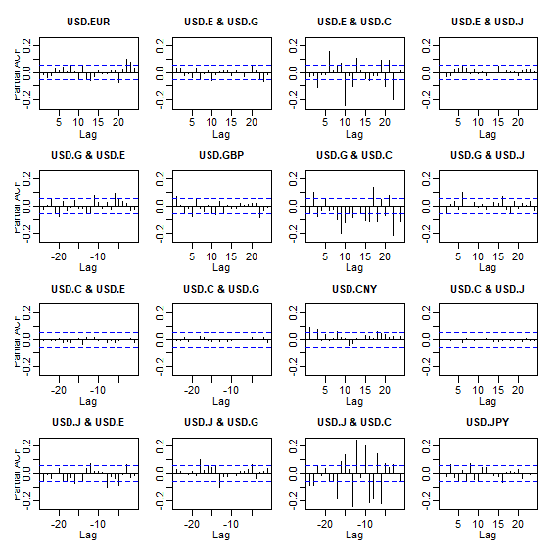
Autocorellogram Examples
acf() function applied to returns
pacf() function applied to returns
Notes:
i.i.d. = independent and identically distributed

Slide 6
Fisher Transformation
Fisher’s “z transformation” of the correlation coefficient
A smoothing routine that helps stabilize the volatility of a variate, expressed as: z = arctanh(r)
Also computed as:
fisher <- function(r) {
0.5 * log((1 + r)/(1 - r))
}
Usage Example:
rho.fisher <- matrix(fisher(as.numeric(R.corr.vols[,1:3])),
nrow = length(ELE.vols),ncol = 3, byrow = FALSE)
Exceptionally useful for small sample sizes.
Characteristics of the transformation:
The distribution of z is approximately normal and "tends to normality rapidly as the sample is increased"
The standard error of z is approximately 1/sqrt(N-3), which is independent of the value of the correlation
Purpose of the transformation:
Test hypothesis about the correlation – perform the test in the z coordinates where all distributions are normal with a known variance.
Compute a confidence interval – perform the computation in the z coordinates and then use the reverse transformation r = tanh(z) to get the results
Notes:
Refer https://blogs.sas.com/content/iml/2017/09/20/fishers-transformation-correlation.html

Slide 7
Quantile Concepts
Developed by Koenker & Bassett (1978).
In Ordinary Least Squares (OLS) regression, equations are designed to estimate the mean of Y conditional on X. In R, use lm() .
Typical method for regular linear regression
Example: we find there is a positive relationship and that the mean weight of males 5’10” is higher than the mean weight of males 5’9″
In quantile regression, equations are designed to estimate the relation of X with Y conditional on quantiles (or percentiles) of Y. In R, use rq() .
Estimate any quantile of y_{t} given x_{t}
Example: we find that the relationship between height and weight changes depending on which quantile we look at
Lets you ask the question: “for whom”
Quantile function
In R, use the quantile(0 function
> x = c(9.1, 7.3, 4.2, 6.6, 8.4, 5.3, 3.9, 2.7)
> quantile(x)
0% 25% 50% 75% 100%
2.700 4.125 5.950 7.575 9.100
Quantile Quantile Plot
Q-Q plot is used to used to compare one distributions with another (typically, normal distribution)
Example:
qqnorm(GNP.resid)
qqline(GNP.resid)

Slide 8
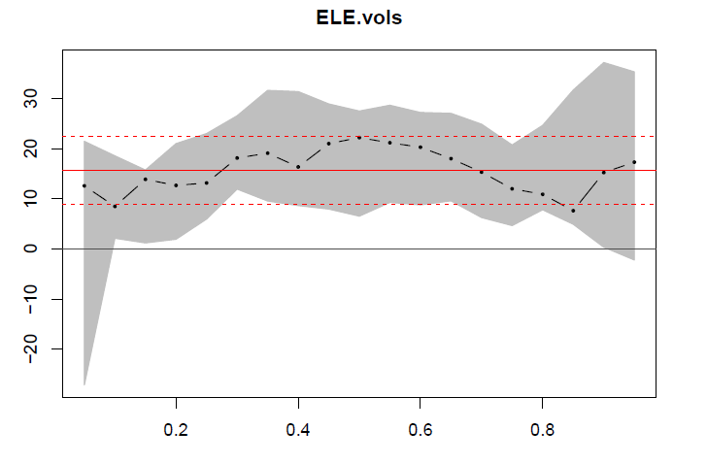
Quantile Example
Example:
sensitivity analysis with parameter estimates of the relationship between correlation and volatility
gray band is a confidence band for the regression line
Partial code:
require(quantreg)
taus <- seq(0.05, 0.95, 0.05)
fit.rq.ELE.IBE <- rq(rho.fisher[, 1] ~
ELE.vols, tau = taus)
fit.lm.ELE.IBE <- lm(rho.fisher[, 1] ~
ELE.vols)
plot(summary(fit.rq.ELE.IBE), parm = "ELE.vols")

Slide 9
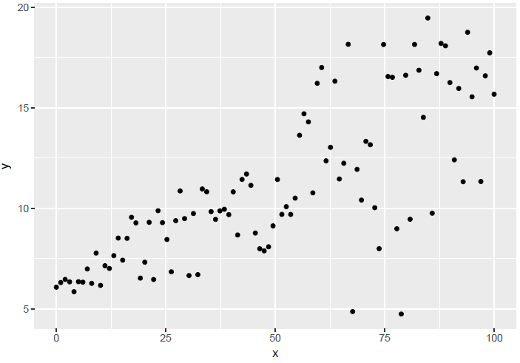
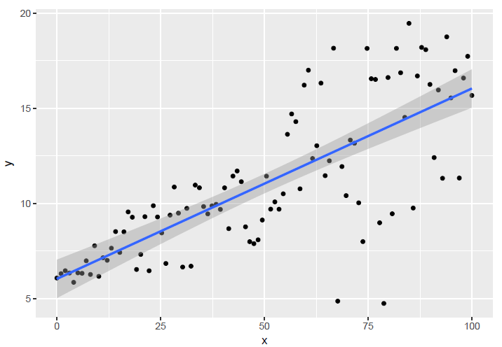
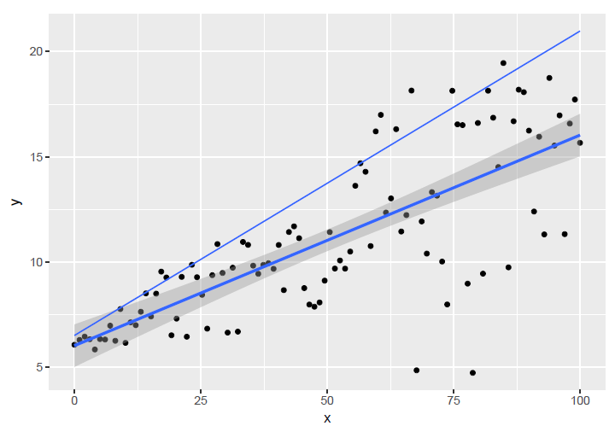
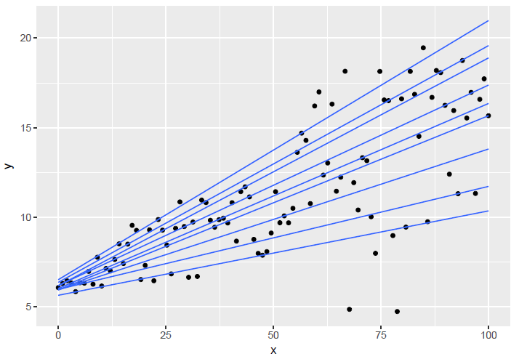
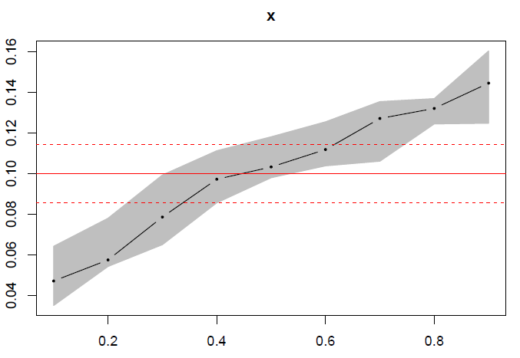
More Quantiles
Progressive Plots
ggplot(dat, aes(x,y)) + geom_point()
ggplot(dat, aes(x,y)) + geom_point() + geom_smooth(method="lm")
ggplot(dat, aes(x,y)) + geom_point() + geom_smooth(method="lm") + geom_quantile(quantiles = 0.90)
ggplot(dat, aes(x,y)) + geom_point() + geom_quantile(quantiles = taus)
taus <- 1:9/10
qreg_fit <- rq(y ~ x, data=dat, tau = taus)
plot(summary(qreg_fit), parm="x")

Slide 10
Reference books
Bennet and Hugen. 2016. Financial Analytics with R: Cambridge Univ Press.
Paul Teetor. 2011. R Cookbook. O’Reilly: Sebastopol, CA.
Phil Spector. Data Manipulation with R.
Norman Matloff. The Art of R Programming: A Tour of Statistical Software Design.
John Taveras. R for Excel Users at https://www.rforexcelusers.com/book/.
Mark J Bennett & Dirk L Hugen. Financial analytics with R : building a laptop laboratory. https://www.safaribooksonline.com/library/view/financial-analytics-with/9781316776094/
Winston Chang. 2014. R Graphics Cookbook. O’Reilly: Sebastopol, CA.

Slide 11
Reference links
http://www.cookbook-r.com/
https://books.google.com/books?id=fxL4tu5bzAAC&printsec=frontcover
https://www.datacamp.com/courses/free-introduction-to-r
http://www.r-tutor.com/r-introduction/
https://www.statmethods.net/
https://livebook.manning.com/#!/book/r-in-action-second-edition/
https://blog.rstudio.com/2015/06/24/leaflet-interactive-web-maps-with-r/
https://www.analyticsvidhya.com/blog/2015/07/guide-data-visualization-r/
https://jabranham.com/blog/2015/09/rmarkdown-vs-latex/
https://www.revolvy.com/main/index.php?s=YAML

